Slide 1
Cholesky Factorization
Project of CS594
By: Amir Saadat
PhD student of Chemical and Biomolecular Eng. Dep.
University of Tennessee

Slide 2
Motivation:
Application in Monte Carlo simulation.
Brownian Dynamic Simulation of Bead-rod and Bead-Spring polymers with Hydrodynamic Interaction .
Solving linear system of equations (resulting in symmetric positive definite A in Ax=b)
…

Slide 3


Definition:
A = L . LT

Slide 4
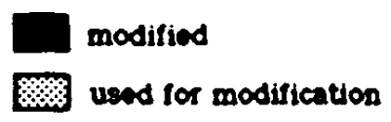

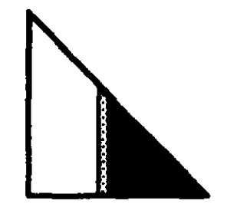
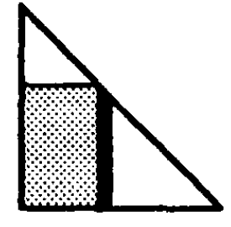
Row Cholesky
Submatrix Cholesky
Column Cholesky

Slide 5
Using Row Cholesky in Serial Comparison with dpotrf_() LAPACK

Slide 6
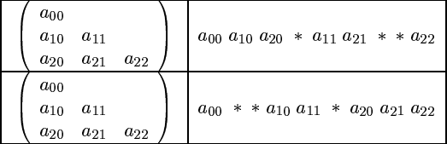
Data Storage
Advantages:
Row major access pattern in doing Column Cholesky
Ease of access
Decreasing the amount of cache misses
Disadvantage
Increment in floating point operations

Slide 7
Parallelizing in Shared Memory using OpenMP
Cholesky_Parallel_OMP( ) {
for j = 1 to n
begin
Pick up task Task_col(j) from task queue
end
}
Col_mod( j, k ) {
for i = j to n
begin
A [i, j] = A [i, j] – A [j, k] * A [i, k]
end
}
Task_col( j ) {
for k = 1 to j-1
begin
Wait until the ready[k] flag has been set
Perform Col_mod(j,k) operation
end
Perform Col_div(j) operation
Set the ready[j] flag
}
MKL_CBLAS calls:
Cblas_daxpy()
Cblas_dscal()

Slide 8
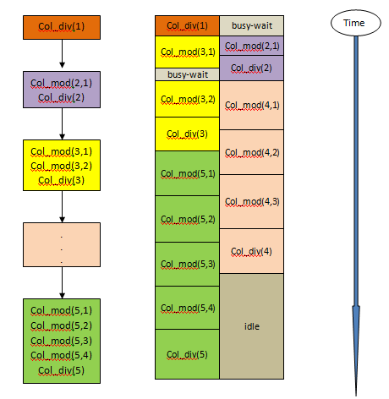

Slide 9
Order of matrix ( n ) | Sequential run- time (sec) | P = 2 |  | p = 4 |  | p = 8
 |  | Parallel run- time (sec) | Speedup | Parallel run- time (sec) | Speedup | Parallel run- time (sec) | Speedup
500 | 0.066575 | 0.573751 | 0.11 | 0.253307 | 0.26 | 0.180856 | 0.39
1500 | 2.741704 | 17.194054 | 0.15 | 5.325873 | 0.52 | 5.500979 | 0.5
2000 | 6.591150 | 15.413304 | 0.42 | 11.252013 | 0.58 | 17.690219 | 0.37
2500 | 14.660367 | 63.760863 | 0.23 | 22.191439 | 0.66 | 19.195476 | 0.76
3000 | 26.775183 | 44.543718 | 0.60 | 55.401160 | 0.48 | 29.904158 | 0.90
3500 | 40.449806 | 165.01936 | 0.24 | 53.391307 | 0.75 | 43.333751 | 0.93
5000 | 152.30613 | 345.0206 | 0.44 | 222.24456 | 0.68 | 121.26268 | 1.25
UNPACKED
Order of matrix ( n ) | Sequential run- time (sec) | P = 2 |  | p = 4 |  | p = 8 |  | p = 8, PLASMA
 |  | Parallel run- time (sec) | Speedup | Parallel run- time (sec) | Speedup | Parallel run- time (sec) | Speedup | Speedup
500 | 0.025132 | 0.072621 | 0.35 | 0.011709 | 2.14 | 0.005930 | 4.23 | 1.33
1500 | 0.504532 | 0.344995 | 1.46 | 0.168797 | 2.98 | 0.114359 | 4.41 | 5.01
2000 | 1.492682 | 0.885646 | 1.68 | 0.412234 | 3.62 | 0.277910 | 5.37 | 5.37
2500 | 3.784008 | 2.047774 | 1.85 | 1.042373 | 3.63 | 0.687795 | 5.50 | 6.09
3000 | 6.834918 | 3.703445 | 1.85 | 2.033217 | 3.36 | 1.268673 | 5.38 | 6.01
3500 | 8.773805 | 5.767410 | 1.52 | 3.036204 | 2.88 | 2.072095 | 4.23 | 6.21
5000 | 34.09648 | 16.31397 | 2.00 | 8.589718 | 3.96 | 5.906355 | 5.77 | 7.23
PACKED

Slide 11
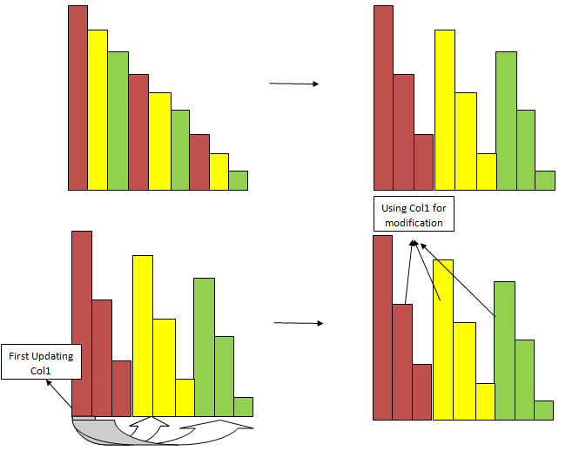
Parallelizing in Distributed Memory using MPI

Slide 13
Summary:
Powerful LAPACK dpotrf() in serial Cholesky.
Column Cholesky in Parallelization (shared Memory).
Significant improvement of parallel Cholesky by using packed storage.
Efficient PLASMA in multicore system.
Block Cyclic distribution and high performance as a result in scaLAPACK.

Slide 14
References:
A. George, M.T. Heath and J. Liu, Parallel Cholesky Factorization on Shared-Memory Multiprocessor, Linear Algebra and its Applications 77:165-187, 1986.
Ref[2]. http://www.netlib.org/blas/blast-forum/chapter2.pdf

